Slide 1
Machine Learning

Slide 2
Evolution of Machine Learning

Slide 3
1. Early Foundations (1940s–1960s)
Roots in statistics, probability, and neuroscience
Goal: make machines “learn” like humans

Slide 4
Milestones
1943 – McCulloch & Pitts: first mathematical model of a neuron
1950 – Alan Turing: Turing Test
1957 – Rosenblatt: Perceptron (first learning algorithm)
Limitations
Very limited computing power
Simple linear models only

Slide 5
2. Symbolic AI & Rule-Based Learning (1960s–1970s)
Approach
Knowledge represented as rules and logic
Learning = manually encoded knowledge

Slide 6
Examples
Expert systems (e.g., medical diagnosis systems)
Decision rules: IF–THEN statements
Problems
Not scalable
Could not handle uncertainty or noisy data

Slide 7
3. Statistical & Classical ML Era (1980s–1990s)
Shift
From rules → data-driven learning
Important Algorithms
Linear & Logistic Regression
k-Nearest Neighbors (k-NN)
Decision Trees (ID3, C4.5)
Naïve Bayes
Support Vector Machines (SVM)
Why it mattered
Better generalization
Strong theoretical foundations (bias–variance tradeoff)

Slide 8
4. Ensemble & Kernel Methods (1990s–2000s)
Key Developments
Random Forests
Boosting (AdaBoost, Gradient Boosting)
Kernel tricks for non-linear learning
Impact
High accuracy on structured/tabular data
Widely used in real-world applications

Slide 9
5. Rise of Big Data & Practical ML (2000s–2010s)
Enablers
Explosion of digital data
Faster CPUs, GPUs
Open-source libraries (Scikit-learn, R)
Applications
Recommendation systems
Spam detection
Credit scoring
Healthcare predictions

Slide 10
6. Deep Learning Revolution (2012–Present)
Breakthrough
2012: AlexNet wins ImageNet using CNNs
Key Models
Convolutional Neural Networks (CNNs)
Recurrent Neural Networks (RNNs, LSTM)
Transformers
Why it works
Learns features automatically
Scales with large datasets & GPUs

Slide 11
Applications
Image & video recognition
Speech recognition
Natural Language Processing
Medical imaging
Microplastic classification (

Slide 12
7. Modern ML & Generative AI (2020–Present)
Trends
Transformers (BERT, GPT)
Self-supervised learning
AutoML
Explainable AI (XAI)
Federated & Edge Learning
Focus
Interpretability
Efficiency
Ethical & responsible AI

Slide 13
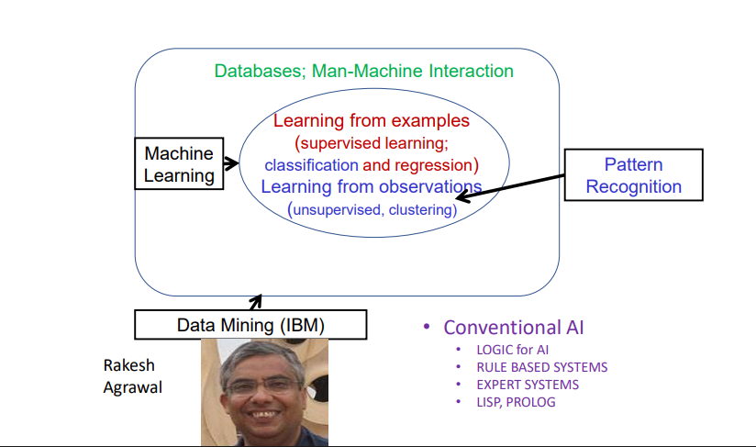
AI

Slide 14
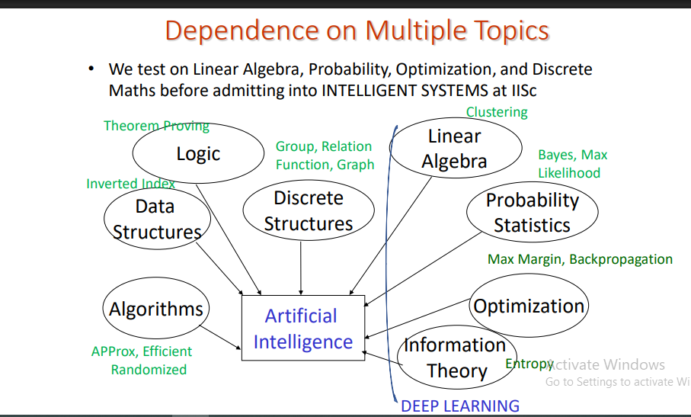
Background Topic of AI

Slide 15
ML Applications
1. Healthcare and Medical Diagnosis
2. Smart Assistants and Human-Machine Interaction
3. Personalized Recommendations and User Experience
4. Fraud Detection and Financial Forecasting
5. Autonomous Vehicles and Smart Mobility

